Slide 1

State Diagrams
Brandon Davis

Slide 2
What is a State DIAGRAM
A state diagram is used to represent the condition of the system or part of the system at finite instances of time. It's a behavioral diagram and it represents the behavior using finite state transitions. State diagrams are also referred to as State machines and State-chart Diagrams.
A state diagram shows the behavior of classes in response to external stimuli. Specifically a state diagram describes the behavior of a single object in response to a series of events in a system. Sometimes it's also known as a Harel state chart or a state machine diagram. This UML diagram models the dynamic flow of control from state to state of a particular object within a system.
Source - https://www.geeksforgeeks.org/unified-modeling-language-uml-state-diagrams/
Source - https://www.smartdraw.com/state-diagram/

Slide 3
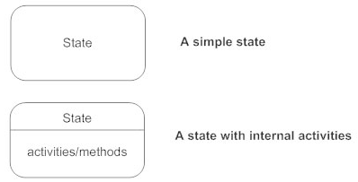

Basic symbols for State Diagrams
States –
Transition -
Initial State -
Source - https://www.smartdraw.com/state-diagram/

Slide 4

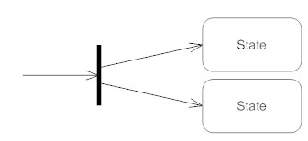
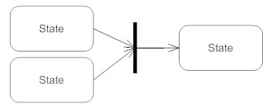
Basic symbols for State Diagrams
Final State -
Fork -
Join -
Source - https://www.smartdraw.com/state-diagram/

Slide 5
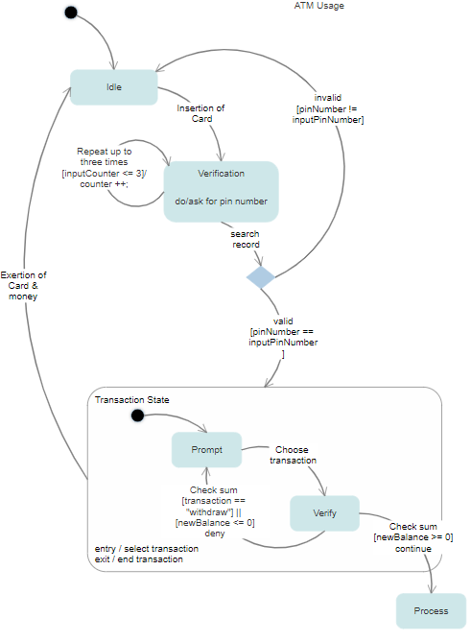
Example 1
Source - https://cloud.smartdraw.com/editor.aspx?templateId=0853040f-1b78-413a-b9d9-bc8e2acd3abe&flags=128

Slide 6
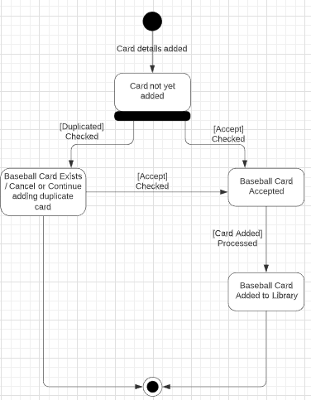
Example 2

